Slide 1

EC4V13-Semiconductor Device Fabrication
Project Based Learning
Automated Wafer Inspection using CNN
YASHWANTH V(24EC3009)
THAMIZH SELVAN S (24EC0233)
MR.RAMESH RAJA
Academic Year : 2026-2027 (ODD Semester)
Zeroth Review

Slide 2
Problem Statement & Objectives
Problem Statement :
Semiconductor wafers often develop surface defects such as cracks, scratches, or contamination, — which reduce yield and reliability. Manual inspection is slow and inconsistent, while traditional automated systems are costly. There is a need for a software‑based AI solution that can detect and classify wafer defects quickly, accurately, and at scale.
Objectives
Develop a Convolutional Neural Network (CNN) model to detect wafer surface defects.
Use wafer image datasets (synthetic or open‑source) for training and testing.
Build a software‑based simulation tool/dashboard to visualize defect detection results.
Achieve high accuracy and confidence scores in defect classify.

Slide 3
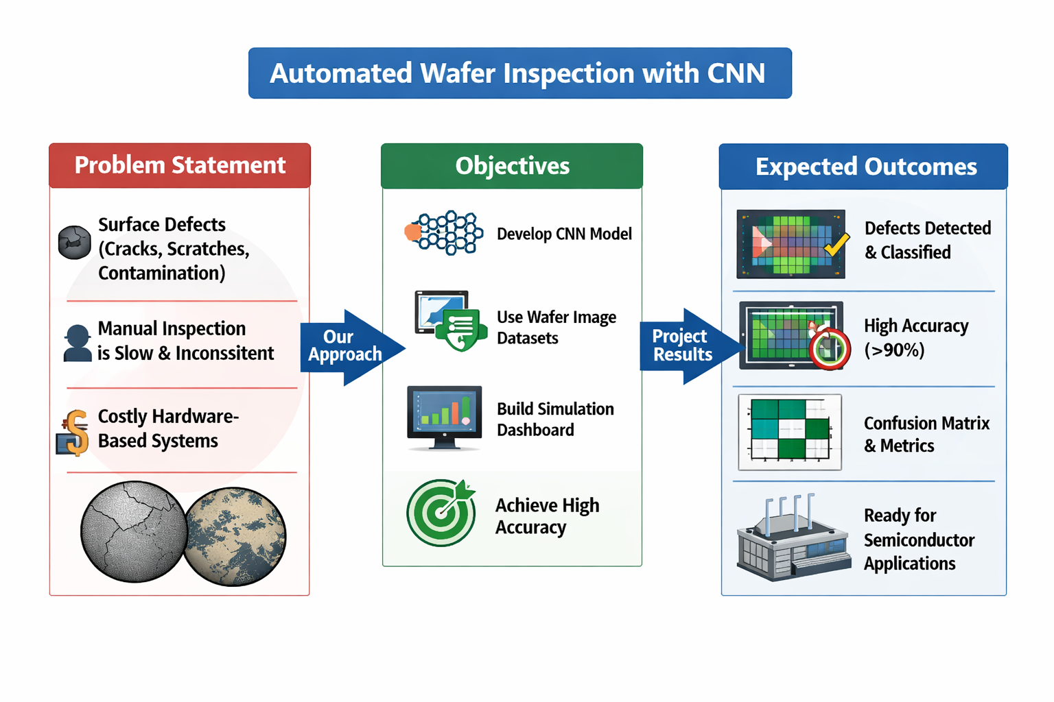

Slide 4
Literature Survey Summary
M. R. Khatun, F. A. Farid, S. Dhar, M. S. Islam, J. Uddin, and H. B. Abdul Karim, “CBAM‑enhanced lightweight CNN for wafer map defect classification,” Frontiers in Electronics, vol. 7, p. 1750707, Mar 2026.
Year | Method / Technology | Key Contribution | Limitation
2021 | Rule‑based Image Processing | Automated detection using filters and thresholds. | High false positives, poor accuracy.
2022 | CNN‑based Wafer Map Classification | First large‑scale CNN use for defect patterns. | Needs large labeled datasets.
2023 | Transfer Learning (ResNet, VGG) | Pre‑trained CNNs adapted for wafer defects. | Limited for rare/stochastic defects.
2024 | Hybrid AI Models (CNN + Attention) | Improved defect localization and accuracy. | Computationally expensive.
2025 | Digital Twin + AI Inspection | Virtual wafer models with CNN prediction. | Complex integration, simulation data required.
2026 | Multi‑modal AI (Optical + E‑Beam + CNN) | Combines imaging with AI for <5 nm nodes. | High cost, slower throughput.

Slide 5
Research Gaps Identified
Research Gaps Identified:
Wafer defect datasets are limited and don’t cover all real‑world defect types.
Manual labeling is slow and inconsistent, reducing CNN accuracy.
CNN models often fail to generalize across different fabrication environments.
Real‑time defect detection and visualization are rarely implemented in software‑only systems.
Lack of explainable AI makes CNN decisions hard to interpret.
Proposed Solution:
Build a software‑based CNN model for wafer defect detection.
Use image preprocessing and augmentation to improve dataset diversity.
Create a dashboard interface to visualize defect type, confidence score.
Integrate Grad‑CAM heatmaps for explainable AI.
Ensure the system is scalable, cost‑effective, and easy to deploy.
Innovation Over Existing Methods
Fully software‑only implementation (no costly hardware).
Real‑time visualization of defect detection results.
Explainable AI integration for transparency.

Slide 6
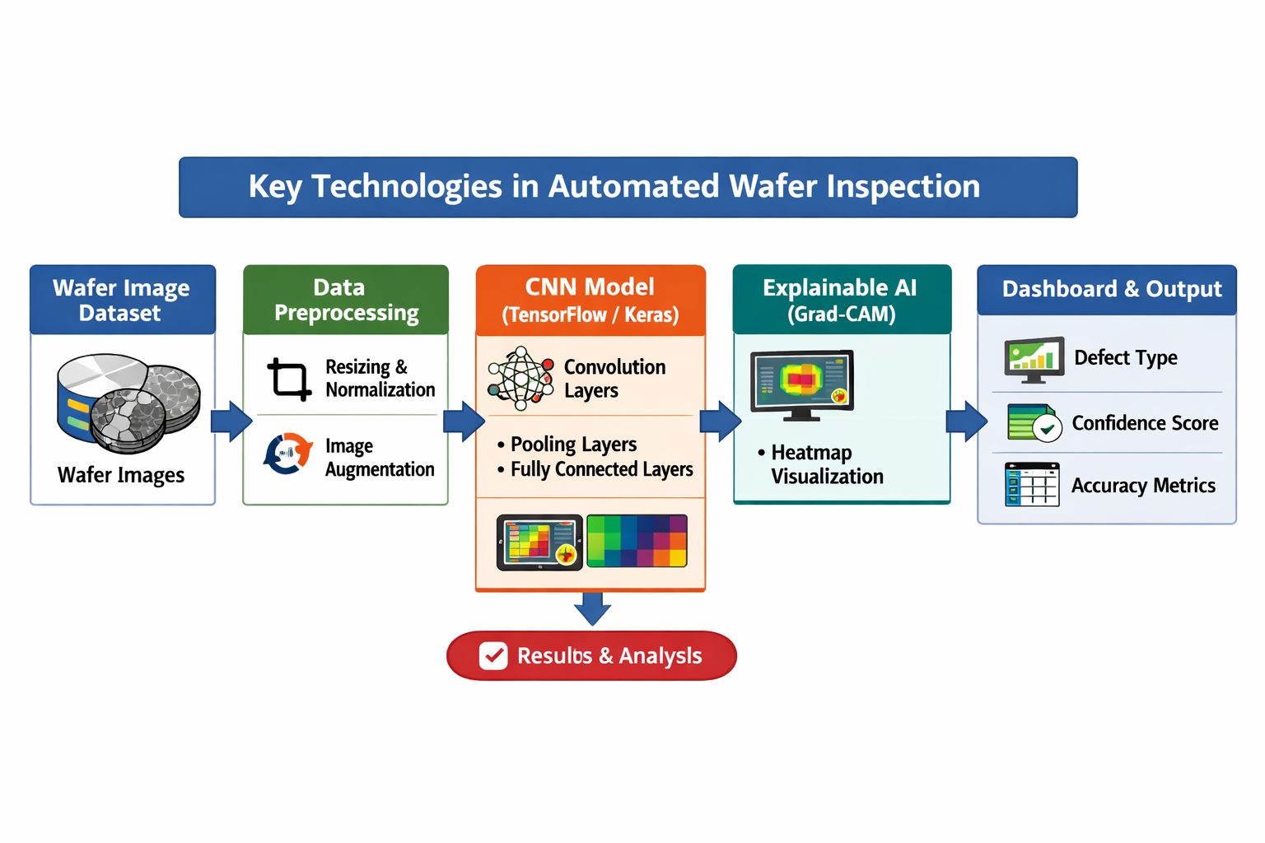
KEY TECHNOLOGIES

Slide 7
Working Procedure
Data Collection:
Gather wafer surface images from open datasets (like WM‑811K) or simulated wafer images.
Include different defect types such as scratches, cracks, and contamination.
Data Preprocessing:
Resize and normalize images for uniform input.
Apply augmentation (rotation, flipping, noise reduction) to improve dataset diversity.
Model Development:
Build a Convolutional Neural Network (CNN) using TensorFlow or Keras.
Train the model to classify wafer defects based on image features.
Model Evaluation:
Test the CNN using unseen wafer images.
Measure performance using accuracy, precision, recall, and confusion matrix.
Explainable AI Integration:
Use Grad‑CAM to generate heatmaps showing which regions the CNN focuses on during classification.
Dashboard Visualization:
Display results such as defect type, confidence score, and accuracy metrics on a user‑friendly dashboard (Streamlit or Flask).
Result Analysis & Improvement:
Analyze model outputs and refine CNN parameters for better accuracy.

Slide 8
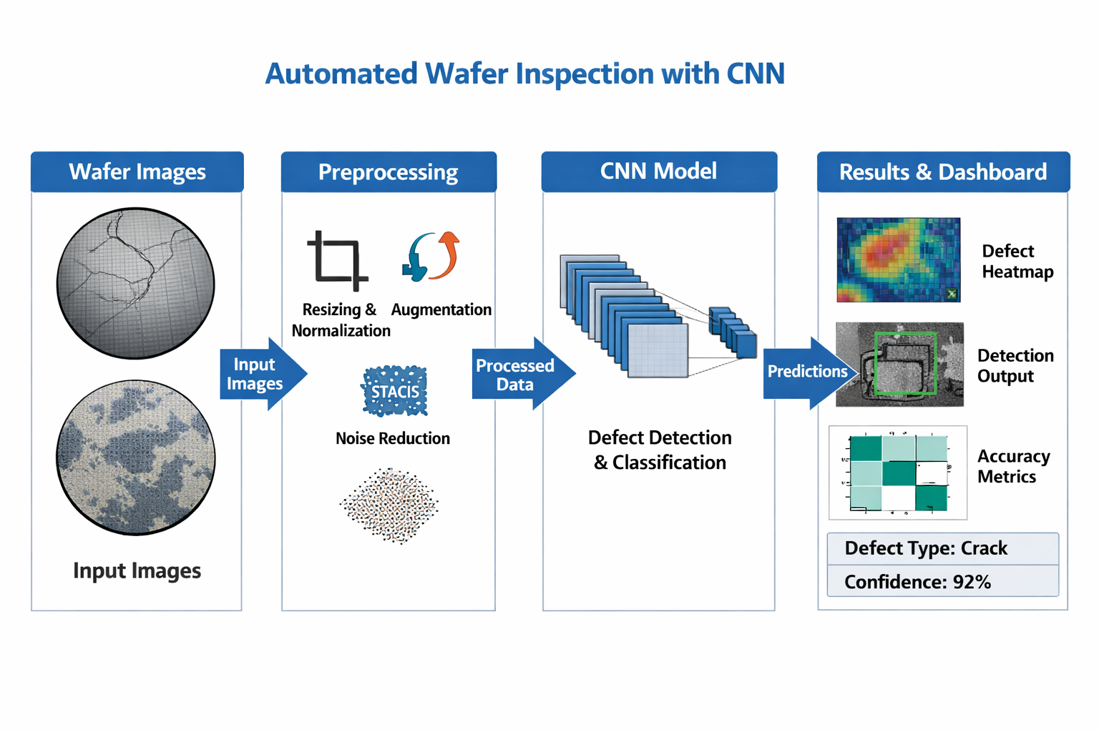

Slide 9
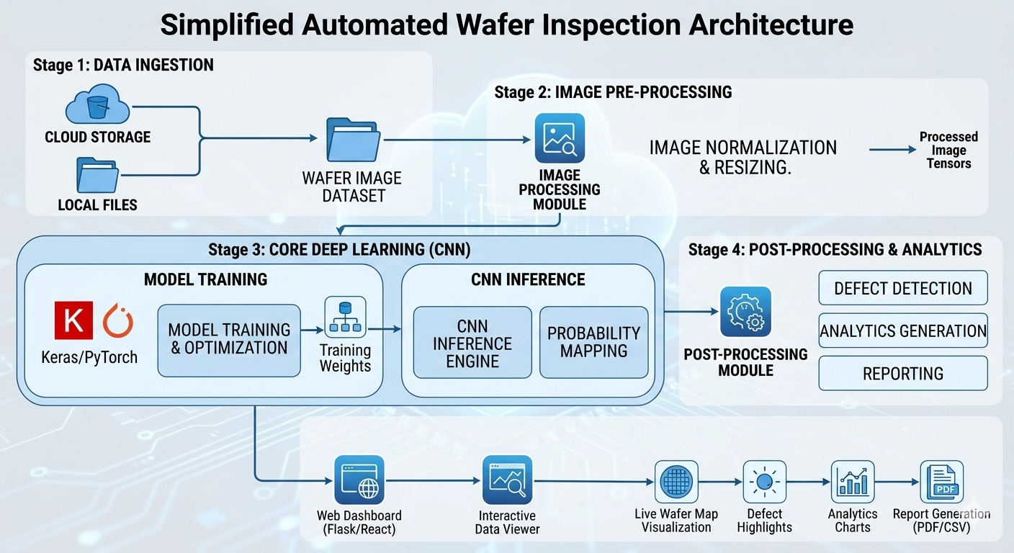
OVERALL OPERATIONS

Slide 10
Innovation Over Existing Methods
Fully Software‑Based Approach
  Unlike traditional wafer inspection systems that rely on expensive hardware sensors, this project uses a purely software‑driven CNN model, reducing cost and complexity.
Real‑Time Visualization
  Integrates a dashboard interface for live defect detection and performance monitoring, enabling faster decision‑making compared to static offline analysis.
Explainable AI Integration
  Uses Grad‑CAM heatmaps to visualize how the CNN identifies defects, improving transparency and trust in AI decisions — a feature missing in most previous models.
Enhanced Dataset Diversity
  Applies image augmentation techniques to simulate multiple defect conditions, improving model robustness and accuracy over limited datasets used in earlier research.
Scalable and Adaptable Design
  The architecture can be easily retrained for different wafer types or manufacturing environments, making it more flexible than fixed hardware‑based systems.

Slide 11
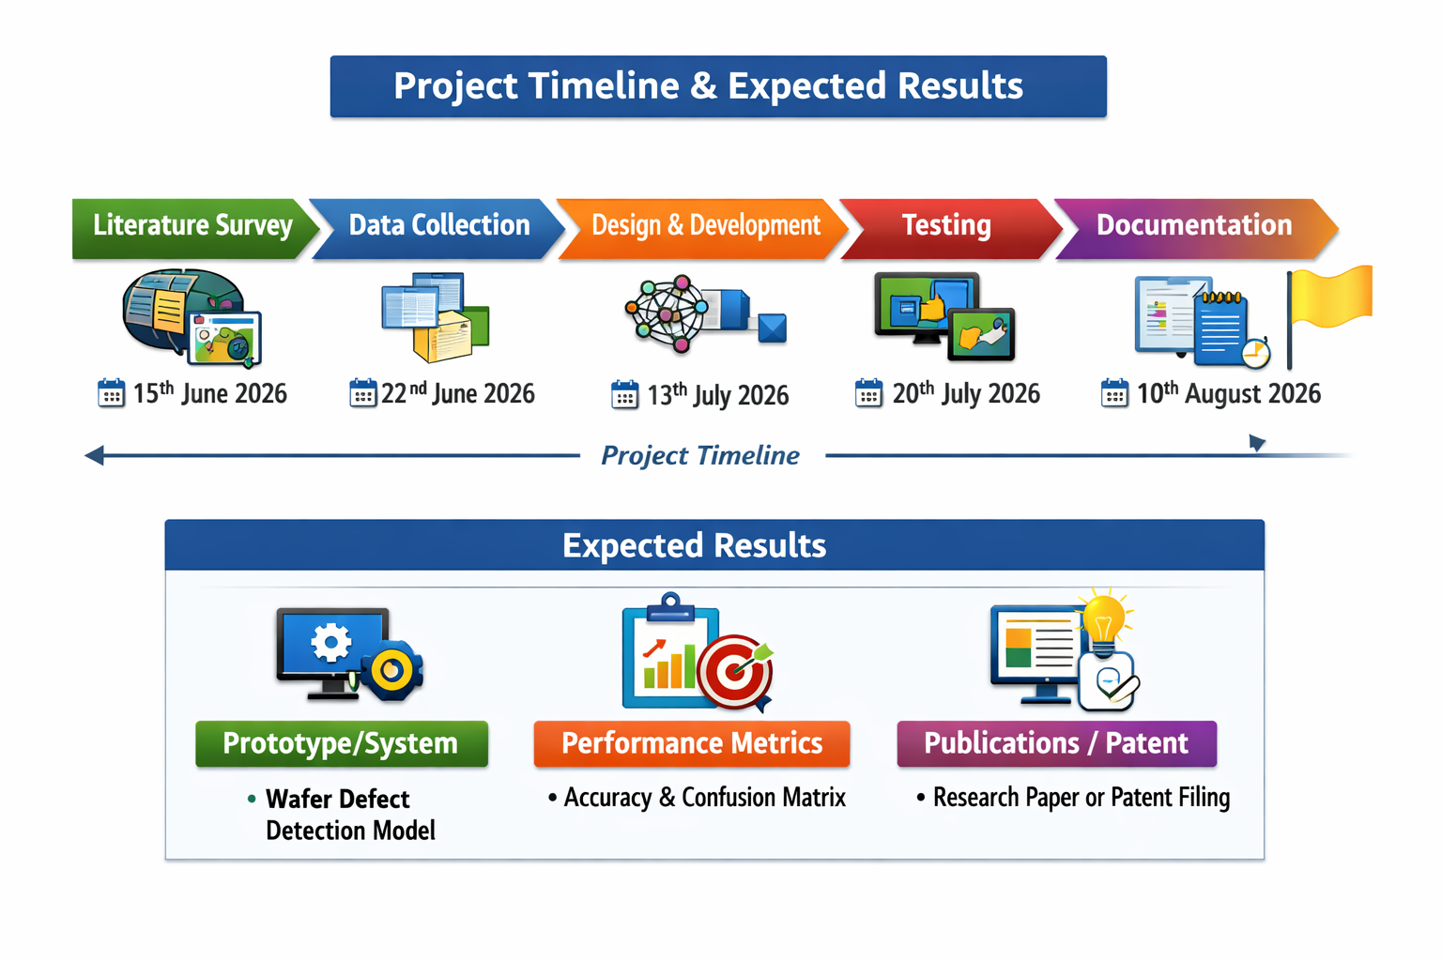
Project Plan & Expected Results

Slide 12
CONCLUSION
The proposed system demonstrates that Convolutional Neural Networks (CNNs) can effectively automate wafer defect detection using a fully software‑based approach. By integrating preprocessing techniques, CNN classification, explainable AI (Grad‑CAM), and a user‑friendly dashboard, the project provides a cost‑effective, scalable, and transparent solution compared to traditional hardware‑dependent inspection methods.
This system not only improves accuracy and reliability in defect classification but also enhances real‑time visualization and interpretability, bridging the gap between academic research and practical semiconductor applications. With further dataset expansion and model optimization, the solution can be adapted for industrial deployment, making wafer inspection faster, more consistent, and more accessible.

